Slide 1
R. Michael Decker (Dr. Horrible / Billy)
Decker is very excited to be a part of Trainwreck’s first musical. Most recent appearances include Smee (Peter Pan), Man-in-White (House of Blue Leaves), Husband (Unlimited), and director of Godless. He is also very excited to be appearing in the “world premieres” of Maggie’s Reconstruction with the Dubuque Fine Art Players and Passages to Palestine at the Strayer-Wood Theater.
Ben Mulgrew (Captain Hammer)
“I am a superhero… I am a superhero… I am… a… superhero?” That’s not what Ben tells himself to get in character, that’s what tells himself because he honestly believes it. Please don’t tell him otherwise, why ruin young dreams? After this summer, Ben might fight crime, save the innocent, or finish senior year at Wahlert.
Tessa Hoffman (Penny)
Tessa is honestly the nicest and sweetest person in this whole production. In fact, if she wrote this bio, she’d probably do something like thank her parents, the cast and crew, her voice teacher – you know, something lame like that. Good thing I didn’t let her write it. Tessa will be a freshman Musical Theater major at Milikin.

Slide 2
This performance
is sponsored in
part by:

Slide 3
Josh Collpitts (Moist, Groupie)
Most recently, Josh has been seen as Wiley (Dearly Beloved), a Wickersham Brother (Seussical), and Renfield (Dracula) for which he received the Outstanding Lead – Thespian Choice Award. He was also in pool (no water) and will be attending UNI to major in Theatre.
Lauren Galliart (Bad Horse, Reporter, Groupie, Mayor)
Would like to thank her job for helping her learn how to multi-task and juggle her multiple personalities in this show. Lauren was most recently seen performing Wendy in the Grand Opera House’s Peter Pan. Lauren is currently attending UNI and majoring in Theatre.
Lara Dohner (Groupie)
Lara was last seen as a split personality in Dubuque Senior High’s Dearly Beloved, and Trainwreck Productions’ collaborative show with Senior High, pool (no water). She is very excited to be playing the creepy-creepy stalker she is. This past year, Lara contributed to Senior’s win of the IHSSA Ensemble Acting All-State Banner.

Slide 4
Sound system
provided by:
2300 John F Kennedy Rd. ♦ Dubuque, Iowa 52002
Phone: 563-556-6052 ♦ www.uncleikes.com

Slide 5
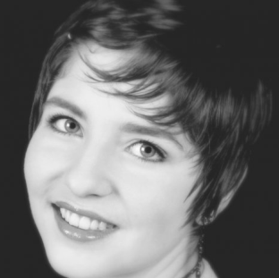
Sarah E. Szeibel (Director, Piano)
Sarah Operates, and by that, I mean sings Opera. Sarah’s last project was directing and playing in Dubuque Senior High School & Anderson Vocal Art Studio’s production of the opera, The Medium. This fall, Sarah will attend Oklahoma City University to study vocal performance and become an opera star.
Kevin Duggan (Bad Horse, Reporter, Guitar)
Kevin Duggan is pretty much awesome… in fact so awesome that his friends don’t speak to him out of fear that they won’t be cool enough. Rocking the guitar as well as the sound system set-up, Kevin’s done stuff I suppose. Go you Mr. Does-whatever-he’s-asked-to-man, you are a true man of genius.
Andrew Lehmkuhl (Stage Manager)
You won’t be seeing Andrew. As you are reading this, he is manning the projection room for this show. Hopefully he doesn’t break anything. Not only don’t you get to see him in this show, but you also don’t get to see a picture of him because we are not Facebook Friends. That means we’re not real friends, right? Fine, be that way!

Slide 6
This performance is sponsored in part by:
FIND
YOUR
VOICE!
Studios in Dubuque, IA & Elizabeth, IL
815.713.9342
andersonvocalarts.com

Slide 7
R. Michael Decker (Dr. Horrible / Billy)
Decker is very excited to be a part of Trainwreck’s first musical. Most recent appearances include Smee (Peter Pan), Man-in-White (House of Blue Leaves), Husband (Unlimited), and director of Godless. He is also very excited to be appearing in the “world premieres” of Maggie’s Reconstruction with the Dubuque Fine Art Players and Passages to Palestine at the Strayer-Wood Theater.
Ben Mulgrew (Captain Hammer)
“I am a superhero… I am a superhero… I am… a… superhero?” That’s not what Ben tells himself to get in character, that’s what tells himself because he honestly believes it. Please don’t tell him otherwise, why ruin young dreams? After this summer, Ben might fight crime, save the innocent, or finish senior year at Wahlert.
Tessa Hoffman (Penny)
Tessa is honestly the nicest and sweetest person in this whole production. In fact, if she wrote this bio, she’d probably do something like thank her parents, the cast and crew, her voice teacher – you know, something lame like that. Good thing I didn’t let her write it. Tessa will be a freshman Musical Theater major at Milikin.

Slide 8
This performance is sponsored in part by:
MULGREW OIL CO.
Oil & Fuel Wholesale
85 Terminal St.
Dubuque, IA 52001
T: 563-583-7386
F: 563-583-7389

Slide 9
Friends of
We thank our major sponsor for this show…
Barons ($150+)
Conductor ($75-149)
Engineers ($25-74)
Brakemen ($5-24)
Bob & Sue Troy
Alex McCarthy
Sue Decker
Lynn Triervieler
R. Michael Decker
Carmen Hernandez
Paige Triervieler
Anna Troy
Mary Zanger
Trainwreck Summer 2009 Board Officers
R. Michael Decker, president
Anna Troy, vice president
Paige Triervieler, secretary
Mary Zanger, treasuer

Slide 10
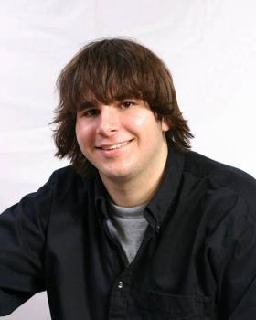
Videography equipment and editing studio provided by:
www.DeckerPhotoVideo.com

Slide 11
DR. HORRIBLE’S
SING-ALONG BLOG

